Slide 1
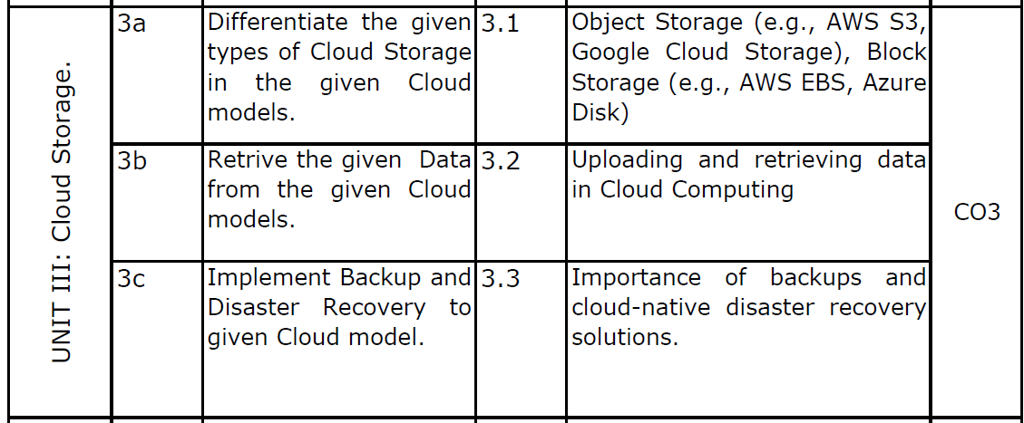
Unit III
Cloud Storage

Slide 2
Cloud Storage Types
Object Storage and Block Storage
Examples: AWS S3, Google Cloud Storage, AWS EBS, Azure Disk

Slide 3
Introduction to Cloud Storage
Cloud storage allows users to store data on remote servers.
It provides scalability, reliability, and accessibility over the internet.

Slide 4
Object Storage
Stores data as objects.
Each object contains data, metadata, and a unique ID.
Used for unstructured data like images, videos, backups.

Slide 5
Examples of Object Storage
AWS S3
Google Cloud Storage
Azure Blob Storage

Slide 6
Advantages of Object Storage
Highly scalable
Cost-effective
Easy data access via APIs
Ideal for big data and backup

Slide 7
Block Storage
Stores data in fixed-size blocks.
Each block acts like a hard drive sector.
Used for databases, virtual machines, and enterprise apps.

Slide 8
Examples of Block Storage
AWS Elastic Block Store (EBS)
Azure Disk Storage
Google Persistent Disk

Slide 9
Advantages of Block Storage
High performance
Low latency
Suitable for transactional applications
Efficient for operating systems and databases

Slide 10
Object Storage vs Block Storage
Object Storage: Used for large unstructured data.
Block Storage: Used for high performance applications.

Slide 11
Azure Storage Services
Blob storage: Stores the unstructured data like images , videos and large files.
E.G : A media company storing high resolution videos for streaming
File storage: Provides fully managed shared file storage in the cloud.
E.G : A team sharing storage file across multiple offices
Queue storage:manages message queue for asynchronous communication.
E.G : A ride hailing app queuing customer request for processing
Table storage: Stores structured NnSQL data
e.g. : An IoT system storing telemetry data from devices.
Disk Storage: Provide virtual hard drives for VMs
e.g.: A financial company running databases on Azure VMs

Slide 12
Azure Storage Tiers
Azure provides different tiers to optimize storage cost
Hot Tier: For frequently accessed data.
e.g. : A SaaS app storing user activity logs for quick analysis
Cool Tier: For infrequently accessed data.
e.g. : Archiving marketing campaigh data accessed quaterly
Archive Tier: for rarely accessed data (long-term storage)
e.g. : Storingcompliance –related documents for 7+ years

Slide 13
Conclusion
Object storage is best for scalable data storage.
Block storage is best for performance-intensive applications.

Slide 14
What is Data Backup and Disaster Recovery?
Data Backup involves creating secure copies of important files and storing them on separate or remote systems,
while Disaster Recovery focuses on restoring those files and maintaining business continuity after an incident.
With cloud computing, backup and recovery have shifted to automated, scalable, and resilient solutions, helping organizations minimize downtime.
Notable service providers include:
AWS Backup: Automated, centralized backups with replication and IAM control (Identity and Access Management ).
Azure Backup: Secures workloads with encryption, retention, and recovery integration.
Google Cloud Storage: Scalable, geo-redundant storage with versioning and lifecycle tools.
IBM Cloud Backup: Flexible, encrypted backups with retention and disaster recovery support.

Slide 15
What is Backup?
Backup is a duplicate copy of important information, including physical (paper) and computer records.
A good backup procedure ensures that data is protected and can be restored when needed.
Data that should be backed up regularly includes:
Email correspondence
Audit files
User information
Utilities and applications
Operating systems
Financial data and databases
Customer lists

Slide 16
Data Backup and Recovery Plan
Factors to consider when creating a backup and recovery plan:
1. Schedule of Backup: Backing up data should be done at convenient and scheduled times.
2. Location of Backup Storage: It is recommended that another copy of backup data is stored remotely in case of disasters like: Fire, Flood, System damage
3. Data Backup Contents : This helps determine:
What data should be backed up
How it should be backed up
When it should be backed up
4. Frequency of Backup : The frequency depends on how often data changes.
5. Time of Data Restoration: Backup planning depends on how quickly the system must be restored.
6. Type of Information :Identify whether data is: Critical, Confidential, General information
7. Backup Media : Backup tapes are cheap, compact, and capable of storing large amounts of data.

Slide 17
Types of Backup Media
1. Disk Drives :Provide high speed backup, but they are relatively expensive.
2. Tape Drives: Capacity ranges from a few megabytes to hundreds of gigabytes.
3. Removable Disks
Fast
Easy to install
Portable
4. Digital Audio Tape (DAT): Provides larger capacity compared to standard tape drives.
5. Optical Jukeboxes : Offer large secure storage capacity (5–20 TB).
6. Autoloader Tape Systems :Use a magazine of tapes to create extended backup volumes. Recommended for businesses requiring very high storage capacity.

Slide 18
Factors in Choosing Backup Media
1. Speed : How fast data can be backed up and recovered.
2. Reliability : Dependability of the backup service and media.
3. Capacity : Amount of data that can be stored.
4. Extensibility : Ability of the backup solution to meet future needs.
5. Cost : The backup solution should fit within the available budget.

Slide 19
Data Backup Security
Backup security is important when the information is:
Confidential
Personal
Proprietary
Security measures include:
Restrict access to backup files.
Secure backup storage locations.
Store backups offsite for safety.

Slide 20
Disaster Recovery
Disaster Recovery is the process of restoring systems and operations after a failure or disaster.

Slide 21
Disaster Recovery Strategies
Plan Restore with Automated System Recovery (ASR)
ASR is a tool used to automatically restore the system after a system failure.
Plan to Backup Open Files
Open files are files that are normally skipped during the backup process.
Backup systems should be designed to ensure open files are also backed up properly.
Plan a Backup Schedule
A backup plan should be based on the requirements for restoring data.
Backup schedules determine:
When backups are taken
How frequently backups occur
How quickly data can be restored

Slide 22
Disaster Recovery Strategies (cont’d)
Some of the common problems encountered during restoration are the following:
Incompatibility in hardware
Missing hardware driver
Corrupted backup media

Slide 23
Disaster Recovery Strategies (cont’d)
Test Restores
Verifying the backup by testing restore is one of the most overlooked aspects of disaster recovery planning.
Backup should be tested to:
Validate the backup
Prepare for recovery
By testing restore, restore procedures can be modified and documented properly.

Slide 24
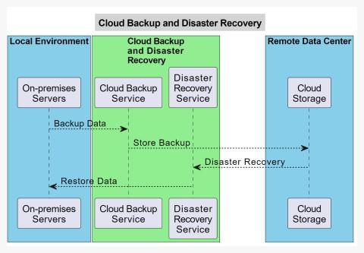
Step-by-Step Process

Slide 25
Step-by-Step Process
Step 1: Choose Your Cloud Backup Provider
Research providers (AWS, Azure, Google Cloud, IBM Cloud)
Compare security, reliability, cost, and scalability
Select the best fit for your needs​
Step 2: Identify What to Back Up
List critical data (customer records, financial files, databases)
Prioritize mission-critical vs. less important data
Determine backup frequency for each data type​
Step 3: Configure Automatic Backups
Set up backup schedule (daily, hourly, or real-time)
Enable encryption for data transmission and storage
Choose backup type (full, incremental, or differential)​

Slide 26
Step-by-Step Process
Step 4: Monitor Backup Performance
Use provider's monitoring dashboard
Set up alerts for backup failures
Review logs regularly to ensure successful completion​
Step 5: Define Recovery Objectives
RTO (Recovery Time Objective): Maximum acceptable downtime
RPO (Recovery Point Objective): Maximum acceptable data loss
Document these goals clearly​
Step 6: Test Your Recovery Process
Simulate disaster scenarios monthly or quarterly
Restore test data to verify it works
Measure actual recovery times
Update procedures based on test results​

Slide 27
Step-by-Step Process
Step 7: Document Everything
Write step-by-step recovery procedures
Include contact information for key personnel
Keep documentation accessible during emergencies​
Step 8: Review and Update Regularly
Update plans after system changes
Incorporate feedback from tests
Track new technologies and best practices

Slide 28
Process Flow
1. Setup Phase: Create a cloud backup provider account and configure backup settings including which files to back up, automatic backup schedule, and encryption settings.​
2. Automated Backup Process: The system initiates backup at the scheduled time, connects to the cloud provider server, validates credentials, encrypts data, transfers it from local storage to cloud, verifies completion, and updates backup logs.
​3. Continuous Monitoring: The system regularly checks backup status. When backups succeed, it logs completion and waits for the next schedule. When backups fail, it alerts the administrator, identifies the cause, and attempts automatic retry if possible
​4. Disaster Recovery Activation: When a disaster occurs (hardware failure, cyberattack, or natural disaster), assess the situation, activate the disaster recovery plan, initiate data restoration from cloud backup, verify restored data integrity, and resume normal operations. Recovery objectives include RTO (maximum time allowed for restoration) and RPO (maximum acceptable data loss).​
5. Regular Testing and Updates: Test the recovery process quarterly by simulating different disaster scenarios, document test results and lessons learned, update procedures based on findings, and track new technologies and best practices.

Slide 29
Real-world examples
Small Business Data Protection: An accounting firm stores client financial records on local servers. Using cloud backup with continuous replication, they protect crucial data in real-time. When ransomware attacks, the firm restores from cloud backup and resumes services with minimal downtime, protecting client relationships.​
E-commerce Website Resilience: An online retailer maintains customer information, product catalogs, and transaction histories. Using cloud disaster recovery with geo-redundant data centers, they create redundant database copies across multiple locations. If one data center fails, operations continue seamlessly.​
Educational Institution Data Protection: Universities accumulate large volumes of student records, research materials, and administrative documents. Cloud backup services protect against data breaches and accidental deletion. Administrators can recover critical information within minutes, ensuring academic continuity.

Slide 30
Why Use Data Backup and Recovery? (Advantages)
1. Data Protection and Redundancy:
Redundant storage across multiple data cents
Protection against hardware crashes, natural events, and cyber attacks
Major providers offer 99.999999999% durability​
2. Scalability:
Virtual storage easily expands or contracts
No new hardware investments needed
Adapts to changing data requirements​
3. Cost-Efficiency:
No hardware infrastructure spending
No maintenance costs
Pay only for storage used​

Slide 31
Why Use Data Backup and Recovery? (Advantages)
4. Accessibility and Flexibility:
Access from any internet-enabled device
Work from any location with internet
Enhances collaboration and efficiency​
5. Automated Backup and Recovery:
Automated backup schedules
Reduced manual intervention
Consistent and accurate backups
Prevents data loss in complex IT environments​
6. Disaster Recovery Capabilities:
Fast restoration after incidents
Business continuity assurance
Minimal operational disruption

Slide 32
Disadvantages
Some disadvantages are:
Internet Dependency: Requires a stable connection; network issues or low bandwidth slow down backup and recovery.
Data Security: Privacy and compliance risks exist; strong encryption, access control, and authentication are essential.
Vendor Reliability: Dependence on the provider’s availability and trustworthiness; vendor failure can impact data recovery.
Data Transfer Speed: Uploading large datasets can be slow, especially with limited bandwidth.
Loss of Control: Storing data in the cloud reduces direct ownership and may limit retention policy control.
Rising Costs: Increasing data volume leads to higher long-term costs; regular cost monitoring is necessary.

Slide 33
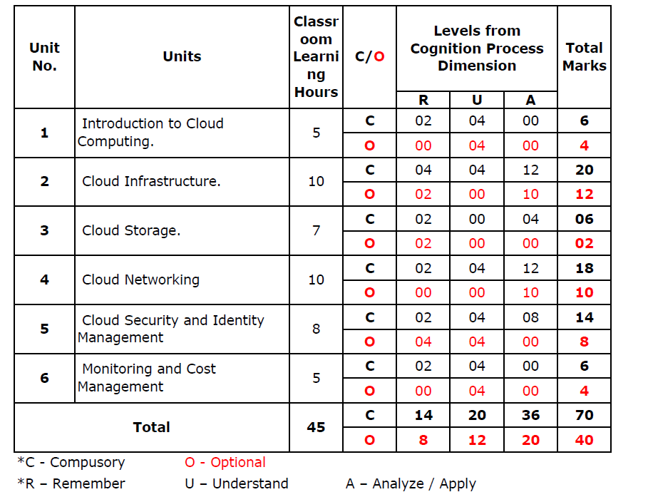

Slide 34
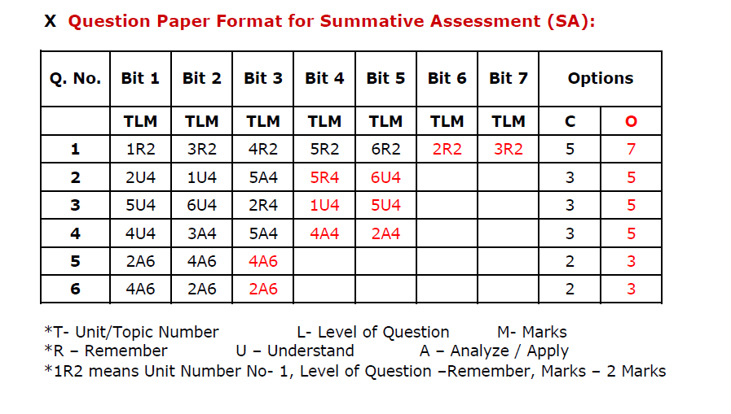

Slide 35
Remember Level Questions (25)
Define Object Storage in cloud computing.
Define Block Storage in cloud computing.
List any two examples of Object Storage services.
List any two examples of Block Storage services.
What is Amazon S3?
What is Google Cloud Storage?
What is Amazon Elastic Block Store (EBS)?
What is Azure Disk Storage?
State any two differences between Object Storage and Block Storage.
What is a bucket in object storage?
What is meant by data retrieval in cloud storage?
List the steps involved in uploading files to cloud storage.
What is a backup in cloud computing?
State the importance of data backup in cloud systems.
What is disaster recovery?
Define cloud-native disaster recovery.
List two advantages of cloud backups.
What is data redundancy in cloud storage?
What is versioning in cloud storage?
What is replication in cloud storage?
What is the purpose of data retrieval mechanisms in cloud systems?
List two types of backup used in cloud systems.
What is meant by cloud storage scalability?
Define data durability in cloud computing.
State the role of cloud storage in disaster recovery.

Slide 36
Application Level Questions (25)
Apply object storage to store multimedia files for a video streaming platform.
Use AWS S3 to upload and retrieve student assignment files in an online learning system.
Demonstrate how block storage can be attached to a virtual machine.
Illustrate the process of uploading data to cloud storage using a diagram.
Apply cloud backup techniques to protect organizational data from accidental deletion.
Show how Google Cloud Storage can be used to host website static files.
Operate a cloud storage service to upload large datasets.
Demonstrate data retrieval from a cloud storage bucket.
Use block storage for database hosting in a cloud environment.
Illustrate the architecture of object storage with a neat diagram.
Apply disaster recovery solutions to restore a failed cloud application.
Demonstrate how automated backups improve system reliability.
Schedule regular backups for a company’s cloud-based database.
Use replication mechanisms to protect cloud data.
Predict the impact of data loss if backups are not maintained in cloud systems.
Illustrate how versioning helps recover deleted files.
Operate a cloud platform to retrieve stored files after a system failure.
Apply cloud storage security measures to protect sensitive data.
Demonstrate the steps to recover data from a backup.
Use disaster recovery strategies to restore services after a cloud outage.
Relate object storage with data archiving applications.
Sketch the architecture of cloud storage backup systems.
Apply automated disaster recovery tools in a cloud environment.
Demonstrate how block storage improves performance of enterprise applications.
Prepare a cloud backup plan for a small organization.

Slide 37

23

